Slide 1
Java Abstraction
Abstraction refers to the ability to make a class abstract in OOP. An abstract class is one that cannot be instantiated.
All other functionality of the class still exists, and its fields, methods, and constructors are all accessed in the same manner. You just cannot create an instance of the abstract class.
If a class is abstract and cannot be instantiated, the class does not have much use unless it is subclass. This is typically how abstract classes come about during the design phase. A parent class contains the common functionality of a collection of child classes, but the parent class itself is too abstract to be used on its own.

Slide 2
Abstract Class:
Use the abstract keyword to declare a class abstract. The keyword appears in the class declaration somewhere before the class keyword.
/* File name : Employee.java */ public abstract classEmployee
{ private String name; private String address; private int number; public Employee(String name,String address,int number)
{
System.out.println("Constructing an Employee"); this.name = name; this.address = address; this.number = number;
} public double computePay()
{
System.out.println("Inside Employee computePay"); return0.0;
} public void mailCheck()
{
System.out.println("Mailing a check to "+this.name
+" "+this.address);
} public String toString()
{ return name +" "+ address +" "+ number;
}

Slide 3
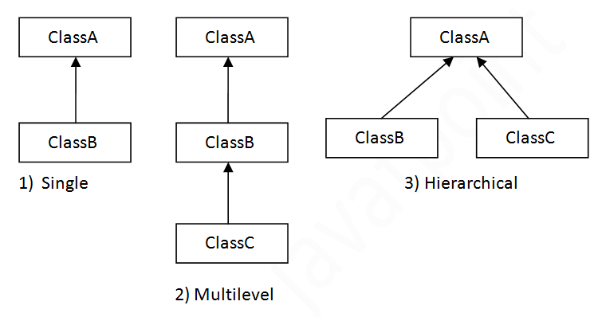
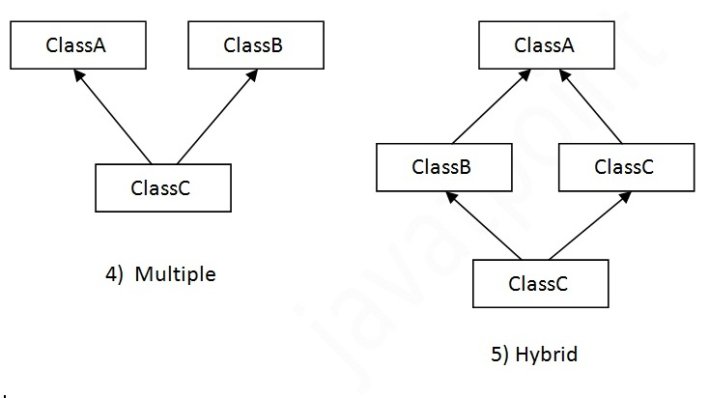
Inheritance
Inheritance in java is a mechanism in which one object acquires all the properties and behaviors of parent object.
Types of inheritance :

Slide 4
Interface
An interface is a collection of abstract methods. A class implements an interface, thereby inheriting the abstract methods of the interface.
An interface is not a class. Writing an interface is similar to writing a class, but they are two different concepts. A class describes the attributes and behaviors of an object. An interface contains behaviors that a class implements.
Unless the class that implements the interface is abstract, all the methods of the interface need to be defined in the class.
An interface is similar to a class in the following ways:
• An interface can contain any number of methods.
• An interface is written in a file with a .java extension, with the name of the interface matching the name of the file.
• The byte code of an interface appears in a .class file.
• Interfaces appear in packages, and their corresponding bytecode file must be in a directory structure that matches the package name.

Slide 5
However, an interface is different from a class in several ways, including:
• You cannot instantiate an interface.
• An interface does not contain any constructors.
• All of the methods in an interface are abstract.
• An interface cannot contain instance fields. The only fields that can appear in an interface must be declared both static and final.
• An interface is not extended by a class; it is implemented by a class.
• An interface can extend multiple interfaces.

Slide 6
Declaring Interfaces:
The interface keyword is used to declare an interface. Here is a simple example to declare an interface:
Example:
Let us look at an example that depicts encapsulation:
/* File name : NameOfInterface.java */ import java.lang.*;
//Any number of import statements public interface NameOfInterface
{
//Any number of final, static fields
//Any number of abstract method declarations\
}
Interfaces have the following properties:
• An interface is implicitly abstract. You do not need to use the abstract keyword when declaring an interface.
• Each method in an interface is also implicitly abstract, so the abstract keyword is not needed.
• Methods in an interface are implicitly public.

Slide 7
Example:
/* File name : Animal.java */ interface Animal{ public void eat(); public void travel();
}
Implementing Interfaces:
When a class implements an interface, you can think of the class as signing a contract, agreeing to perform the specific behaviors of the interface. If a class does not perform all the behaviors of the interface, the class must declare itself as abstract.
Aclass uses the implements keyword to implement an interface. The implements keyword appears in the class declaration following the extends portion of the declaration.
/* File name : MammalInt.java */ public class MammalInt implements Animal{ public void eat(){
System.out.println("Mammal eats");
} public void travel(){
System.out.println("Mammal travels");
} public int noOfLegs(){ return0;
}

Slide 8
When overriding methods defined in interfaces there are several rules to be followed:
• Checked exceptions should not be declared on implementation methods other than the ones declared by the interface method or subclasses of those declared by the interface method.
• The signature of the interface method and the same return type or subtype should be maintained when overriding the methods.
• An implementation class itself can be abstract and if so interface methods need not be implemented.
When implementation interfaces there are several rules:
• A class can implement more than one interface at a time.
• A class can extend only one class, but implement many interfaces.
• An interface can extend another interface, similarly to the way that a class can extend another class.

Slide 9
class Box {
double width;
double height;
double depth;
Box() {
}
Box(double w, double h, double d) {
width = w;
height = h;
depth = d;
}
void getVolume() {
System.out.println("Volume is : " + width * height * depth);
}
}
public class MatchBox extends Box {
double weight;
MatchBox() {
}
MatchBox(double w, double h, double d, double m) {
super(w, h, d);
weight = m;
}
public static void main(String args[]) {
MatchBox mb1 = new MatchBox(10, 10, 10, 10);
mb1.getVolume();
System.out.println("width of MatchBox 1 is " + mb1.width);
System.out.println("height of MatchBox 1 is " + mb1.height);
System.out.println("depth of MatchBox 1 is " + mb1.depth);
System.out.println("weight of MatchBox 1 is " + mb1.weight);
}
}

